Slide 1
Graduate Artificial Intelligence CS 640 Rule-based Systems
Jeffrey Considine
jconsidi@bu.edu

Slide 2
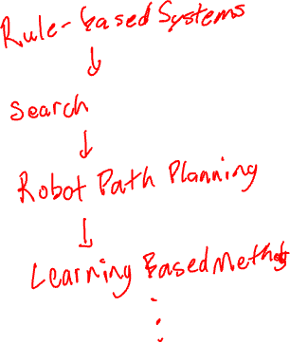
Plan for Today
Good old-fashioned AI
Prolog
Expert systems
Closing thoughts

Slide 3
Good Old-Fashioned AI (GOFAI)
Focused on logic, symbolic computations.
Dismissive of fuzzy, connectionist approaches.
Not clearly defined.
Maybe a compliment or diss depending on context.

Slide 4
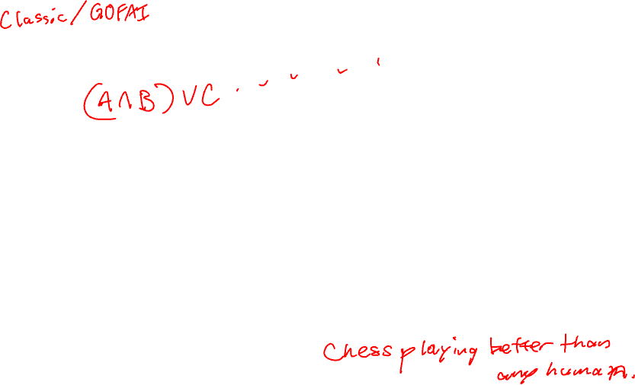
Symbols vs ???
Logic
Proofs
Symbol manipulation
Exhaustive search (allowing heuristic speedups)
Slow and incomplete, but results are certain?
Statistical machine learning
Neural networks and approximation
Sometimes fast, but results are never certain?

Slide 5
Any Questions?

Slide 6
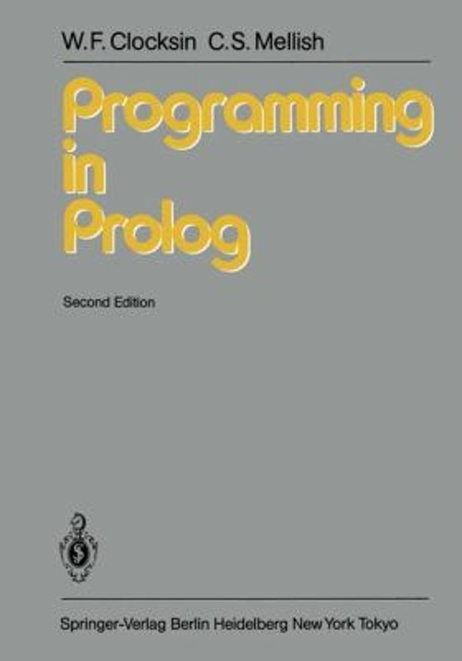
Prolog
A “logic programming” language first developed in 1972.
Turing-complete
Only will look at deduction support.
Image via https://www.ebay.com/itm/277137966092
Prolog examples are all from this book.

Slide 7
Prolog - Facts
likes(john,mary).
likes(mary,john).
valuable(gold).
female(jane).
owns(john,gold).
father(john,mary).
gives(john,book,mary).
What do these mean?
First part is relationship.
Then objects separated by commas in parenthesis.
Order matters.
Period ends the fact.
All relationships and objects names start with lowercase letter.

Slide 8
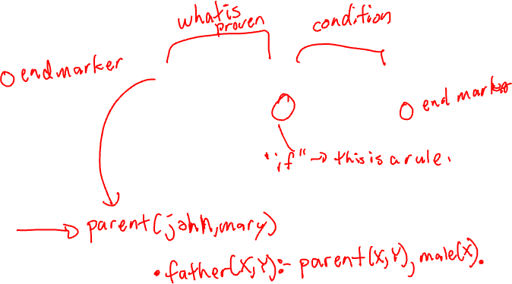
Prolog - Rules
likes(john,mary).
likes(mary,john).
valuable(gold).
female(jane).
owns(john,gold).
father(john,mary).
gives(john,book,mary).
parent(X,Y) :- father(X,Y).
parent(X,Y) :- mother(X,Y).

Slide 9
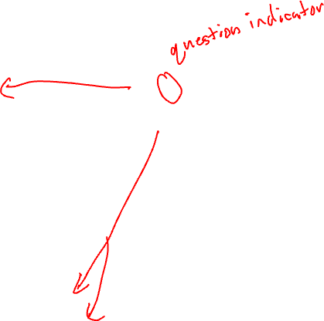
Prolog - Questions
likes(john,mary).
likes(mary,john).
valuable(gold).
female(jane).
owns(john,gold).
father(john,mary).
gives(john,book,mary).
parent(X,Y) :- father(X,Y).
parent(X,Y) :- mother(X,Y).
?- likes(john,mary).
?- parent(john,patrick).

Slide 10

Prolog - Answers
Any question will get one of these two answers.
Yes: relationships matching the question provably do exist.
No: relationships matching the question cannot be proven.
Nuances:
All answers are given the current facts and rules.
There is no way to say the relationships cannot exist with more rules or facts.

Slide 11
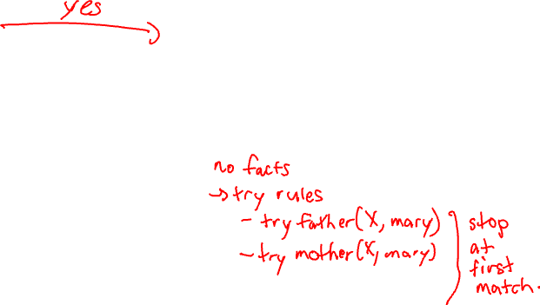
Prolog – Variables
likes(john,mary).
likes(mary,john).
valuable(gold).
female(jane).
owns(john,gold).
father(john,mary).
gives(john,book,mary).
parent(X,Y) :- father(X,Y).
parent(X,Y) :- mother(X,Y).
?- likes(john,X).
?- parent(X,mary).

Slide 12
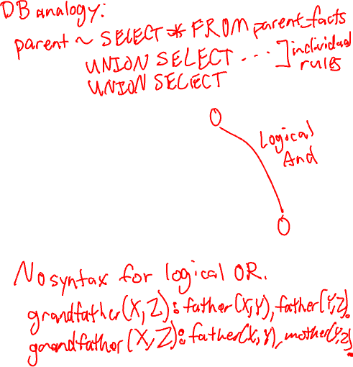
Prolog – Conjunctions
likes(john,mary).
likes(mary,john).
valuable(gold).
female(jane).
owns(john,gold).
father(john,mary).
gives(john,book,mary).
parent(X,Y) :- father(X,Y).
parent(X,Y) :- mother(X,Y).
?- gives(john,X,mary), valuable(X).
grandfather(X,Z) :- father(X,Y), parent(Y,Z).

Slide 13
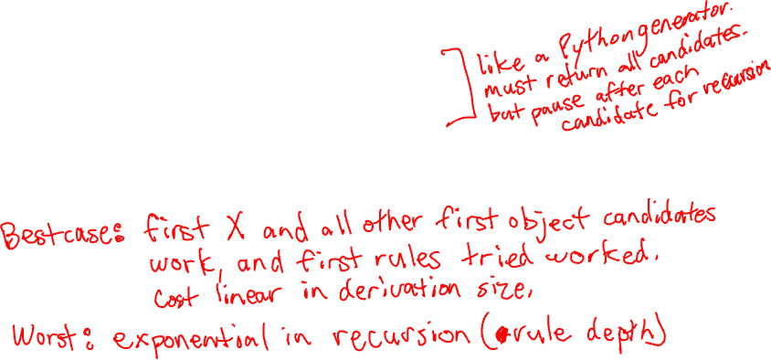
Prolog – Inference
?- gives(john,X,mary), valuable(X).
First try to find X such that gives(john,X,mary).
Check facts first.
Then check for rules (recursion).
For each such X found, recursively try to solve the rest of the question.
So recurse on valuable(X).
Backtracking will be used unless first choice of X succeeds.

Slide 14
Prolog – Inference Costs?

Slide 15
How much could we prove this way?
???

Slide 16
Prolog – Limitations of Deductions
Only proving positive statements.
Negative statements (no answers) were added as an extension.
Assumption was that relation did not hold if it could not be proven.
What about this?
foo(X) :- not foo(X).
Only works for deterministic statements.
No concept of “probably”.

Slide 17
Limitations of These Rules
can_fly(X) :- bird(X).
🐧?

Slide 18
Probability vs Fuzzy vs Exceptions
If you say most birds can fly, what does that mean?
Are we building a conditional probability model?
Or are exceptions white/blacklisted?
Or just hand waving?
can_fly(X) :- bird(X), not cannot_fly(X).
Is this better?
General tension between positive vs negative rules.

Slide 19
Any Questions?

Slide 20
What is an Expert System?
Expert system
= Knowledge-based system
= Knowledge navigator
= Rule-based system
= Deduction/reaction system
= Recommendation system
= Software agent
CS 640: Artificial Intelligence, Margrit Betke, Yiwen Gu, 2024

Slide 21
Early Successful Expert Systems
Most Famous Industry Products:
Mavent: check mortgage loans against a variety of laws and regulation, review for compliance.
Mycin: diagnose bacterial infections and recommend antibiotic treatments.
XCON: configure orders for new computer systems.
Many More Agricultural Expert Systems:
LIMEX: Assessment, irrigation, fertilization, and pest control recommendations to assist lime growers
Tomatex (tomatoes)
Citex (oranges)
Cupex (cucumbers)
Neper Wheat
Source: WIKI
CS 640: Artificial Intelligence, Margrit Betke, Yiwen Gu, 2024
Notes:
Mavent is an automated compliance system specifically designed to assist in the review of mortgage loans for regulatory compliance. It checks mortgage loans against a variety of laws and regulations, such as the Truth-in-Lending Act (TILA), Home Ownership and Equity Protection Act (HOEPA), and other regulations.
and other federal, state, and local regulations. By 2017, Mavent had reviewed over 28 million loans, helping lenders ensure that they are in compliance before finalizing transactions.
Mavent follows a set of predefined rules derived from mortgage compliance laws,
It applies these rules to loan data in a highly structured way, evaluating each loan against the legal requirements to identify potential compliance violations.
Mycin. Physicians usually must begin antibiotic treatment for patient who have bacterial infections without knowing exactly which organism is the culprit. No time to wait for definitive lab culture evidence. Broad spectrum vs Disease specific (better) – backward chaining
XCON. Big mainframe computer. Components, input-output buses, suitable slots.

Slide 22

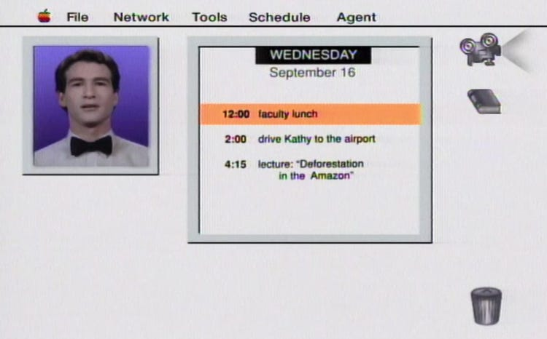
Not So Successful Office Assistants
Microsoft’s "Clippit" or "Clippy“
Lack of Intelligence
Intrusiveness
Apple’s Knowledge Navigator
Concept video
Not an actual product
→ Siri, a hybrid, incorporates rule-based components for specific tasks (e.g. "set a timer")
CS 640: Artificial Intelligence, Margrit Betke, Yiwen Gu, 2024
Notes:
Key Reasons for Clippy’s Failure:
Intrusiveness: Clippy often popped up at inappropriate times, offering help that wasn't needed. This was seen as distracting and annoying to many users.
Lack of Intelligence: Clippy's suggestions were often irrelevant or simplistic, leading users to feel that it wasn’t truly helpful or understanding what they were trying to accomplish. Its rule-based system couldn't grasp complex tasks or adapt to users' needs.
Negative User Experience: Rather than being helpful, Clippy was often mocked and parodied for being unhelpful. It became the subject of user frustration and jokes, symbolizing poorly implemented AI.
User Interface Design: Clippy's cartoonish design and animations didn’t fit well in professional settings. Many users felt that it detracted from productivity.
Now at this point you might think, Ok, every thing nowadays uses big models …

Slide 23
Expectation up to recently
Traditional Expert Systems based on
hand-crafted rules and
search algorithms like
Depth-First-Search (DFS) or
Bread-First-Search (BFS)
would be replaced by or in combination with systems based on Machine Learning.
CS 640: Artificial Intelligence, Margrit Betke, Yiwen Gu, 2024

Slide 24
Research Trend since 2020
Early, rule-based approaches to expert systems need to be understood to develop a new-generation expert system.
Pure data-based (statistical) machine learning may not be the answer .
Recent research trend: Combination of rule-based systems and knowledge bases (domain knowledge) with statistical machine learning systems.
CS 640: Artificial Intelligence, Margrit Betke, Yiwen Gu, 2024

Slide 25
Expert Systems Around Us
When you call your bank…
Interactive Voice Response (IVR) systems. These systems prompt users with a series of pre-recorded messages and options, allowing them to navigate menus by pressing numbers or, in some cases, using voice commands.
When you browse some website…
Website Chatbots. If you visit a customer service page, the chatbot might ask questions like, "How can I help you today?" and provide options such as "Track my order" or "Return a product." Based on your selection, the chatbot follows a programmed path.
CS 640: Artificial Intelligence, Margrit Betke, Yiwen Gu, 2024

Slide 26
Types of Expert Systems, Rule Syntax
Rule-based Deduction Systems
Reaction Systems
Rule Syntax:
R_{n} : IF if1
if2
…
THEN then1
then2
then3
…
antecedents
consequents
CS 640: Artificial Intelligence, Margrit Betke, Yiwen Gu, 2024

Slide 27
Circuit Visualization
if1
if2
if3
….
Rn
then1
then2
then3
….
AND Gate
IF all antecedents of Rn are satisfied
THEN rule is “triggered” or
action is “fired”
CS 640: Artificial Intelligence, Margrit Betke, Yiwen Gu, 2024

Slide 28
Terminology
“Antecedent” = assertion
“Consequent” = assertion in deduction system
= reaction in reaction systems
Fact = something true (never false)
Assertion = statement that something is true (can be false)
CS 640: Artificial Intelligence, Margrit Betke, Yiwen Gu, 2024

Slide 29
Facts or Assertions?
It’s going to be sunny tomorrow.
Assertions
It’s going to be sunny tomorrow, according to the weather forecast.
Facts
An apple everyday keep the doctor away.
Assertions
Milk is good for your health.
Assertions
Milk is a good source of calcium, which is important for bone health.
Facts
CS 640: Artificial Intelligence, Margrit Betke, Yiwen Gu, 2024

Slide 30
Terminology
“Antecedent” = assertion
“Consequent” = assertion in deduction system
= reaction in reaction systems
Fact = something true (never false)
Assertion = statement that something is true (can be false)
“ Working Memory” = collection of assertions
“ Forward Chaining” = moving from IF to THEN:
CS 640: Artificial Intelligence, Margrit Betke, Yiwen Gu, 2024

Slide 31
Reference: Patrick Winston’s AI book
Example: ZooKeeper
Deduction system to identify animals in a zoo
7 animals:
cheetah, tiger, giraffe, zebra, ostrich, penguin, albatross
1st idea: Build a rule for each type of animal:
R_{n} : IF all characteristics of an animal
THEN This is animal of type n
=> 7 rules with long list of antecedents
CS 640: Artificial Intelligence, Margrit Betke, Yiwen Gu, 2024

Slide 32
Reference: Patrick Winston’s AI book
Example: ZooKeeper
Deduction system to identify animals in a zoo
7 animals:
cheetah, tiger, giraffe, zebra, ostrich, penguin, albatross
2nd idea: Create rules that produce intermediate assertions
Reduce number of antecedents by checking common characteristics
Produce intermediate assertions
Compute chains of conclusions
Z1: IF ?x has hair
THEN ?x is a mammal
?x is a variable
CS 640: Artificial Intelligence, Margrit Betke, Yiwen Gu, 2024

Slide 33
More Terminology
If the assertion “Stretch has hair” is in the working memory, variable x can be bound to Stretch
We also say “Stretch is the binding of x”
If all variables in the antecedent are bound, the rule is instantiated
CS 640: Artificial Intelligence, Margrit Betke, Yiwen Gu, 2024
Notes:
Suppose that a particular animal named Stretch has hair….

Slide 34
ZooKeeper Rules
Z6: IF ?x is a mammal
?x has pointed teeth
?x has claws
?x has forward-pointing eyes
THEN ?x is a carnivore
Z7: IF ?x is a mammal
?x has hoofs
THEN ?x is an ungulate
Z8: IF ?x is a mammal
?x chews cud
THEN ?x is an ungulate
Z9: IF ?x is a carnivore
?x has tawny color
?x has dark spots
THEN ?x is a cheetah
Z1: IF ?x has hair
THEN ?x is a mammal
Z2: IF ?x gives milk
THEN ?x is a mammal
Z3: IF ?x has feathers
THEN ?x is a bird
Z4: IF ?x flies
?x lays eggs
THEN ?x is a bird
Z5: IF ?x is a mammal
?x eats meat
THEN ?x is a carnivore
CS 640: Artificial Intelligence, Margrit Betke, Yiwen Gu, 2024

Slide 35
ZooKeeper Rules Cont.
Z13: IF ?x is a bird
?x does not fly
?x has long legs
?x has long neck
?x is black and white
THEN ?x is an ostrich
Z14: IF ?x is a bird
?x does not fly
?x swims
?x is black and white
THEN ?x is a penguin
Z15: IF ?x is a bird
?x is a good flyer
THEN ?x is an albatross
Z10: IF ?x is a carnivore
?x has tawny color
?x has black strips
THEN ?x is a tiger
Z11: IF ?x is an ungulate
?x has long legs
?x has long neck
?x has tawny color
?x has dark spots
THEN ?x is a giraffe
Z12: IF ?x is an ungulate
?x has white color
?x has black stripes
THEN ?x is a zebra
CS 640: Artificial Intelligence, Margrit Betke, Yiwen Gu, 2024

Slide 36
Example: What is Stretch?
Working Memory:
Stretch has hair
Stretch chews cud
Stretch has long legs
Stretch has a long neck
Stretch has tawny color
Stretch has dark spots
CS 640: Artificial Intelligence, Margrit Betke, Yiwen Gu, 2024

Slide 37
Forward Chaining Procedure
Until no rule produces a new assertion,
For each rule,
For each set of possible variable bindings determined by matching the antecedents to working memory,
Instantiate the consequent.
Determine whether the instantiated consequent is already asserted. If it is not, assert it.
CS 640: Artificial Intelligence, Margrit Betke, Yiwen Gu, 2024
Notes:
Try to support each of the rule’s antecedents by matching it to assertions in the working memory (known)

Slide 38
Forward Chaining circuit visualization
What is Stretch?
Z1
Stretch has hair
mammal
Z8
ungulate
Stretch chews cud
Z11
Stretch has long legs
Stretch has a long neck
Stretch has tawny color
Stretch has dark spots
Stretch is a giraffe
CS 640: Artificial Intelligence, Margrit Betke, Yiwen Gu, 2024
Notes:
Ungulate: uhng·gyuh·luht
Herbivorous: ur·bi·vr·uhs herbivore: ur·buh·vor

Slide 39
Backward Chaining Procedure
Until all hypotheses have been tried and none have been supported or until success,
For each hypothesis,
Find a rule whose consequent matches the hypothesis and create a binding set
Try to support each of the rule’s antecedents by matching it to assertions in the working memory or by backward chaining through another rule, creating new hypotheses. Be sure to check all matching and instantiation alternatives.
If all the rule’s antecedents are supported, announce success and conclude that the hypothesis is true.
CS 640: Artificial Intelligence, Margrit Betke, Yiwen Gu, 2024
Notes:
So far, deduction-oriented rule-based system that works from given assertions to new, deduced assertions. → Forward
Backward is also possible: start with some hypothesis
For each rule whose consequent matches the current hypothesis…

Slide 40
Example: What is Swifty?
Working Memory:
Swifty has hair
Swifty has pointed teeth
Swifty has claws
Swifty has forward-pointing eyes
Swifty has tawny color
Swifty has dark spots
Hypothesis:
“Swifty is a cheetah”
CS 640: Artificial Intelligence, Margrit Betke, Yiwen Gu, 2024

Slide 41
Backward Chaining circuit visualization
What is Swifty?
“Swifty is a cheetah”
Z9
carnivore
tawny color
dark spots
Z5
mammal
eats meat
×
Z1
has hair
√
CS 640: Artificial Intelligence, Margrit Betke, Yiwen Gu, 2024

Slide 42
Backward Chaining circuit visualization
What is Swifty?
“Swifty is a cheetah”
Z9
carnivore
tawny color
dark spots
Z5
mammal
eats meat
×
Z1
has hair
√
CS 640: Artificial Intelligence, Margrit Betke, Yiwen Gu, 2024

Slide 43
Backward Chaining circuit visualization
What is Swifty?
√
“Swifty is a cheetah”
Z9
carnivore
tawny color
dark spots
√
√
√
Z5
Z6
mammal
eats meat
mammal
pointed teeth
claws
forward-pointing eyes
×
√
√
√
Z1
Z1
has hair
has hair
√
√

Slide 44
Forward vs. Backward Chaining
Which direction is better?
Fan-in << Fan-out
backward
Fan-in >> Fan-out
forward
CS 640: Artificial Intelligence, Margrit Betke, Yiwen Gu, 2024
Notes:
Fan-in << fan-out: backward chaining. Only need to verify few conditions
Fan-in >> fan-out: forward chaining: because backward chaining would have to verify too many conclusions

Slide 45
Forward vs. Backward Chaining
Which direction is better?
Similar fan-in and fan-out:
Backward chaining if
Interested in only one of many possible conclusions
Interested in only a general conclusion (“carnivore”)
Facts not gathered yet, only gather useful facts
Forward chaining if
Animal disappeared, cannot gather new facts
CS 640: Artificial Intelligence, Margrit Betke, Yiwen Gu, 2024

Slide 46
Rule-Based Reaction System
ZooKeeper is a deduction system
An example of the reaction system: Bagger
Bag groceries in the store
Four steps:
The check-order step, make suggestions
The bag-big-items step, big bottles first
The bag-medium-items step, frozen items go to freezer bag
The bag-small-items step
CS 640: Artificial Intelligence, Margrit Betke, Yiwen Gu, 2024

Slide 47
Rule-Based Reaction System: Bagger
IF all antecedents of Rn are satisfied
THEN rule is “triggered” or
action is “fired”
B2: IF step is check-order
THEN step is no-longer check-order
step is bag-big-items
B2: IF step is check-order
DEL step is check-order
ADD step is bag-big-items
CS 640: Artificial Intelligence, Margrit Betke, Yiwen Gu, 2024

Slide 48
Example: Bagger
Item | Container Type | Size | Frozen?
Bread | Plastic bag | Medium | No
Glop | Jar | Small | No
Granola | Cardboard box | Large | No
Ice cream | Cardboard carton | Medium | Yes
Potato chips | Plastic bag | Medium | No
Pepsi | Bottle | Large | No
Initial Working Memory:
Step is check-order
Bag1 is the current bag
Bread is to be bagged
Glop is to be bagged
Granola is to be bagged
Ice cream is to be bagged
Potato chips are to be bagged
CS 640: Artificial Intelligence, Margrit Betke, Yiwen Gu, 2024
Notes:
B1 → (yes)

Slide 49
Example: Bagger
Item | Container Type | Size | Frozen?
Bread | Plastic bag | Medium | No
Glop | Jar | Small | No
Granola | Cardboard box | Large | No
Ice cream | Cardboard carton | Medium | Yes
Potato chips | Plastic bag | Medium | No
Pepsi | Bottle | Large | No
Working Memory:
Step is check-order
Bag1 is the current bag
Bread is to be bagged
Glop is to be bagged
Granola is to be bagged
Ice cream is to be bagged
Potato chips are to be bagged
Step is check-order
Bag1 is the current bag
Bread is to be bagged
Glop is to be bagged
Granola is to be bagged
Ice cream is to be bagged
Potato chips are to be bagged
Pepsi is to be bagged
B1
→ (yes) →
→
CS 640: Artificial Intelligence, Margrit Betke, Yiwen Gu, 2024
Notes:
B1 → (yes) →

Slide 50
Example: Bagger
Item | Container Type | Size | Frozen?
Bread | Plastic bag | Medium | No
Glop | Jar | Small | No
Granola | Cardboard box | Large | No
Ice cream | Cardboard carton | Medium | Yes
Potato chips | Plastic bag | Medium | No
Pepsi | Bottle | Large | No
Working Memory:
Step is bag-large-items
Bag1 contains Pepsi
Bag1 contains granola
Bag1 is the current bag
Bread is to be bagged
Glop is to be bagged
Ice cream is to be bagged
Potato chips are to be bagged
Step is bag-medium-items
Bag1 contains Pepsi
Bag1 contains granola
Bag1 is the current bag
Bread is to be bagged
Glop is to be bagged
Ice cream is to be bagged
Potato chips are to be bagged
B2, B3, B4
→ → →
B6
→
→
CS 640: Artificial Intelligence, Margrit Betke, Yiwen Gu, 2024
Notes:
B1 → (yes) →

Slide 51
Example: Bagger
Item | Container Type | Size | Frozen?
Bread | Plastic bag | Medium | No
Glop | Jar | Small | No
Granola | Cardboard box | Large | No
Ice cream | Cardboard carton | Medium | Yes
Potato chips | Plastic bag | Medium | No
Pepsi | Bottle | Large | No
Working Memory:
Step is bag-medium-items
Bag1 contains Pepsi
Bag1 contains granola
Bag2 is the current bag
Bag2 contains bread
Bag2 contains ice cream (in freezer bag)
Bag2 contains potato chips
Glop is to be bagged
Step is bag-small-items
Bag1 contains Pepsi
Bag1 contains granola
Bag2 is the current bag
Bag2 contains bread
Bag2 contains ice cream (in freezer bag)
Bag2 contains potato chips
Glop is to be bagged
B9, B8, (B7, B8), B8
→ → → →
B10
→
→
CS 640: Artificial Intelligence, Margrit Betke, Yiwen Gu, 2024
Notes:
B1 → (yes) →

Slide 52
Example: Bagger
Item | Container Type | Size | Frozen?
Bread | Plastic bag | Medium | No
Glop | Jar | Small | No
Granola | Cardboard box | Large | No
Ice cream | Cardboard carton | Medium | Yes
Potato chips | Plastic bag | Medium | No
Pepsi | Bottle | Large | No
Working Memory:
Step is done
Bag1 contains Pepsi
Bag1 contains granola
Bag2 contains bread
Bag2 contains ice cream (in freezer bag)
Bag2 contains potato chips
Bag3 is the current bag
Bag3 contains glop
B12, B11, B13
→ → →
CS 640: Artificial Intelligence, Margrit Betke, Yiwen Gu, 2024

Slide 53
Conflict Resolution Strategies
Rule ordering based on:
Priority list: Rule ordering
Context: Groups of rules, only one group active at any time
Specificity:
Conditions of R1 & R2: Use R1 ( the superset)
Data: Prioritize assertions, use the triggered rule with highest priority assertion in conditions list
Size: Use triggered rule with longest list of conditions
Recency: Use least recently used rule
R2
R1
CS 640: Artificial Intelligence, Margrit Betke, Yiwen Gu, 2024

Slide 54
Mood Swings with Expert Systems
🤩 If we can sit down with an expert long enough…
😬 It’s so hard to cover all the edge cases.
🧐 Can we learn all the rules?
⌚️ Write some facts and rules, learn others…
Use large language models here?

Slide 55
Any Questions?

Slide 56
Rule-based Systems are Rigid?
???

Slide 57
The Cyc Project
>40 year effort to encode knowledge
Capable of 1st order logic.
Understands “usually”.
All data human approved, but more recently using LLMs and other tools to generate candidate entries.
Meta rules to pick between “lines of reasoning” and conflicting conclusions ← fuzziness comes back here
Source: https://arxiv.org/abs/2308.04445

Slide 58
Where does Fairness and Morals Go?
???

Slide 59
Any Questions?

